Slide 1



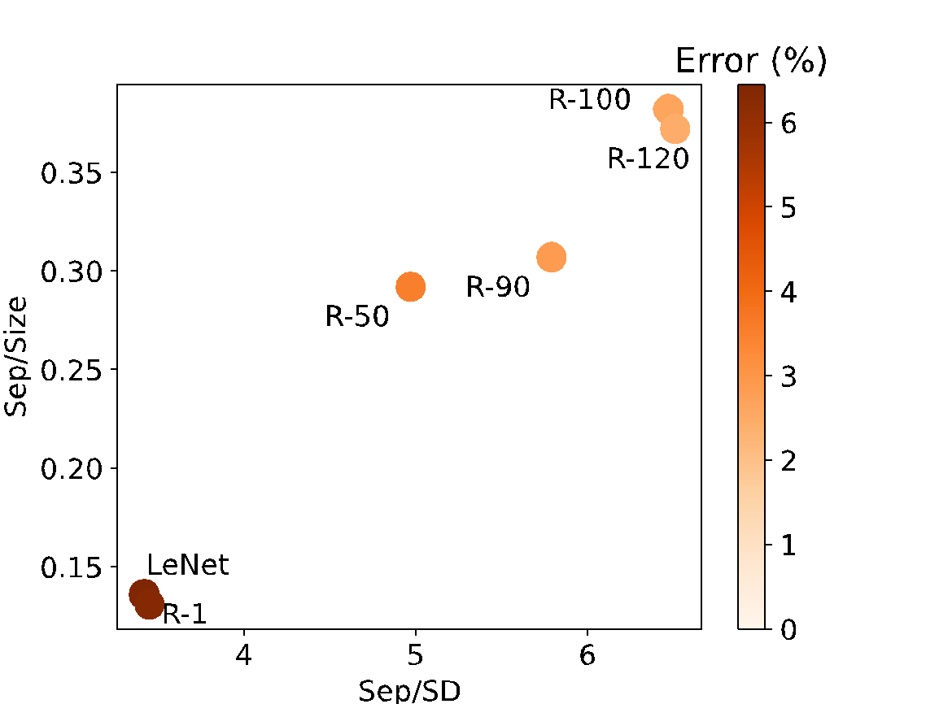
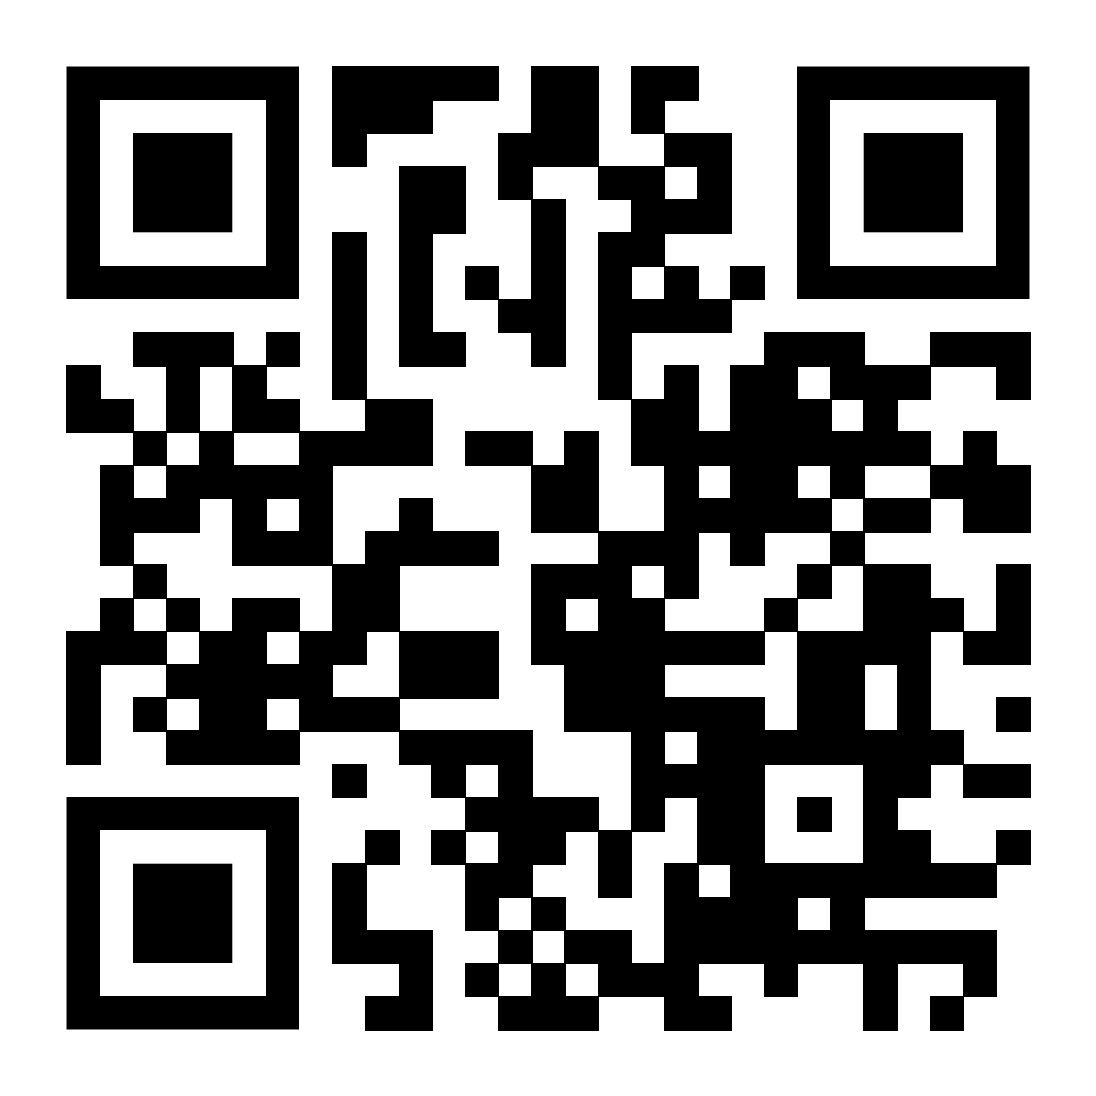
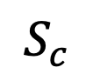
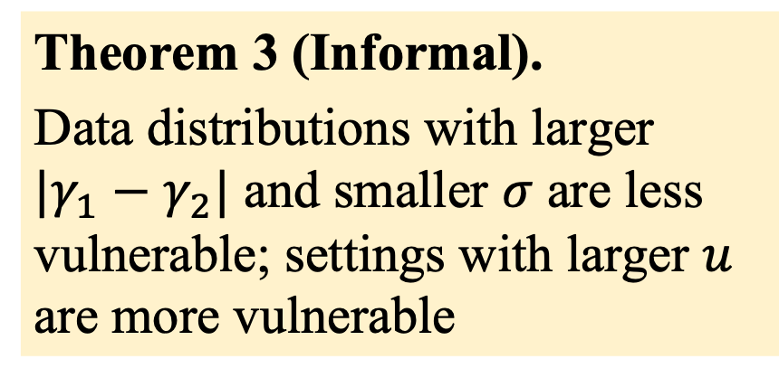
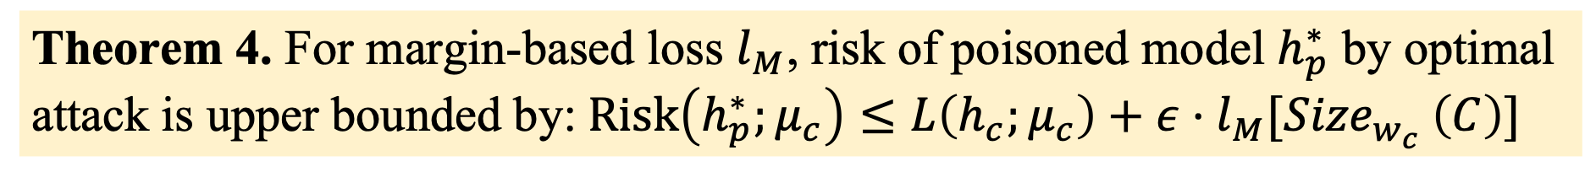
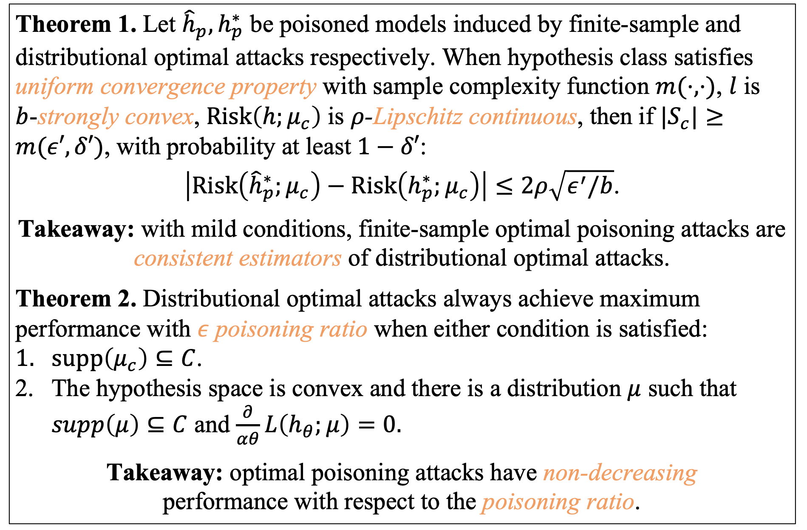
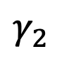
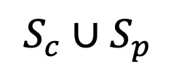
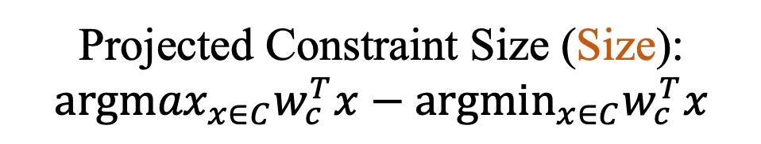
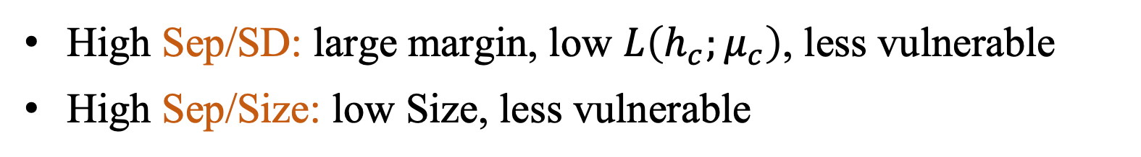
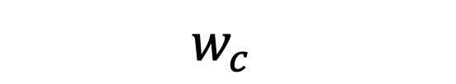
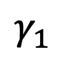
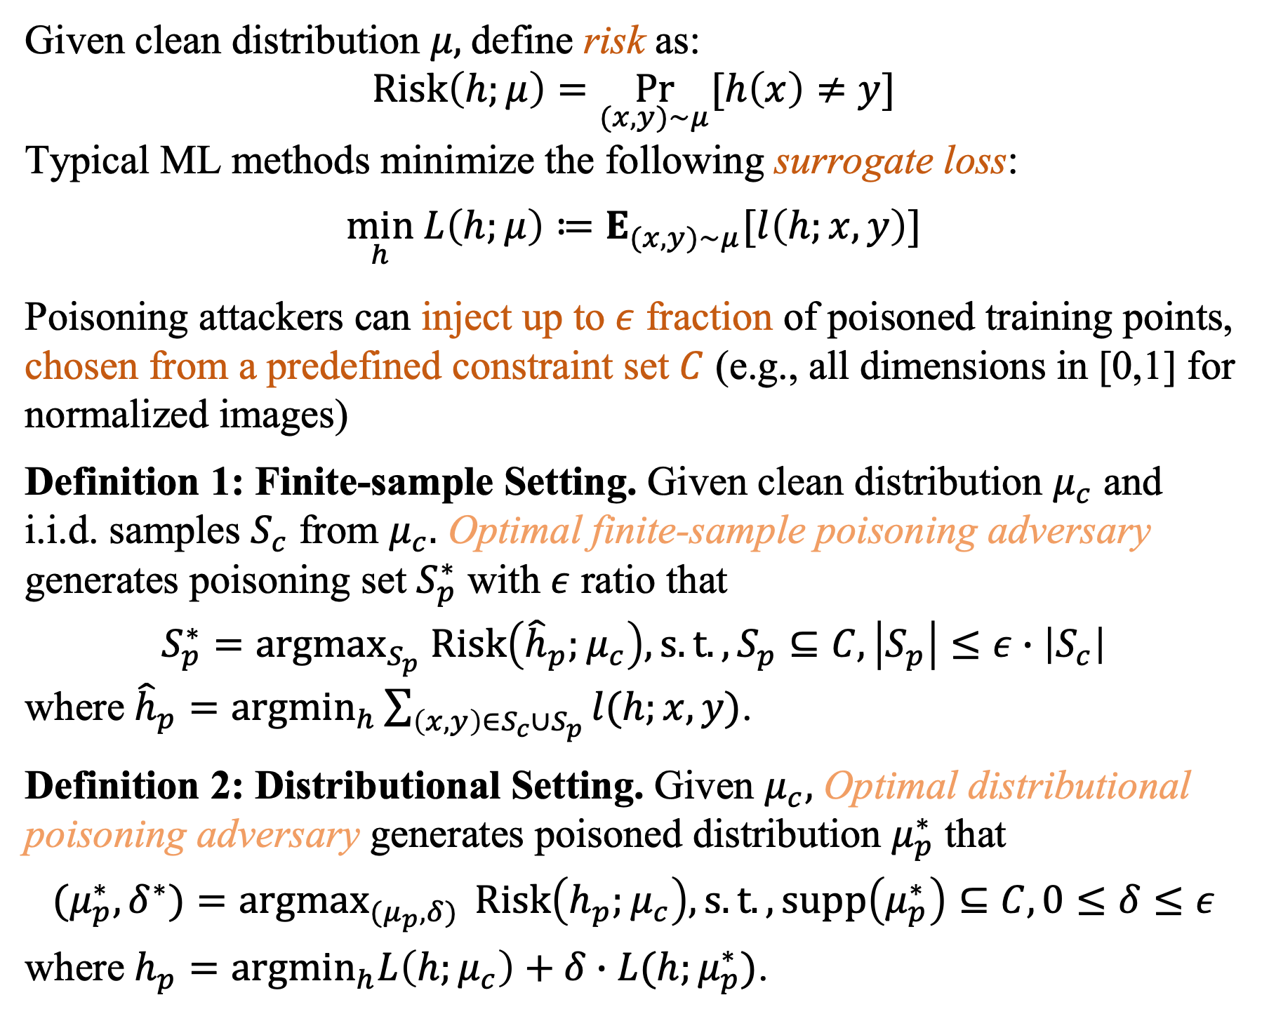
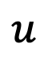
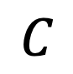
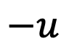
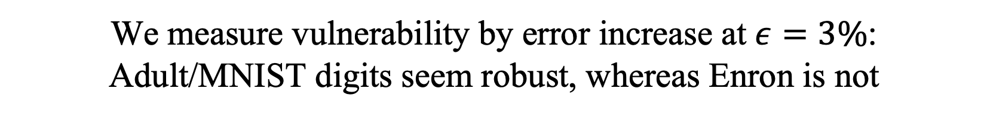
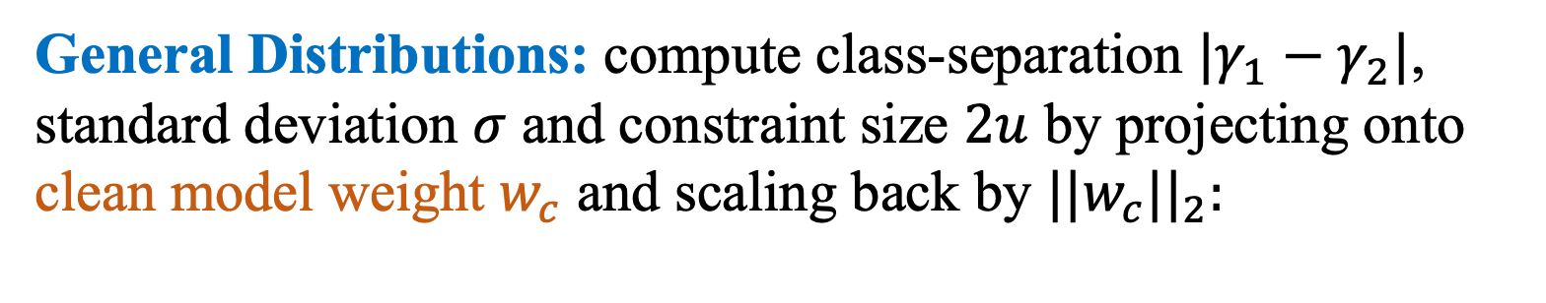
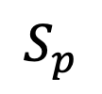
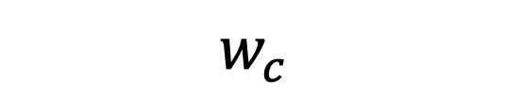
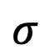
What Distributions are Robust to Indiscriminate
Poisoning Attacks for Linear Learners?
Fnu Suya, Xiao Zhang, Yuan Tian , David Evans
Indiscriminate Poisoning Attacks
Main Theoretical Results
Explaining Dataset Vulnerability
$$S_{c}∪S_{p}$$
Theorem 1. Let ${{\hat{h}}_{p},h}_{p}^{∗}$ be poisoned models induced by finite-sample and distributional optimal attacks respectively. When hypothesis class satisfies uniform convergence property with sample complexity function $m(⋅,⋅)$, $l$ is $b$-strongly convex, $Risk\left(h;μ_{c}\right)$ is $ρ$-Lipschitz continuous, then if ${|S}_{c}|≥m(ε′,δ′)$, with probability at least $1−δ′$:
$\left|Risk\left({\hat{h}}_{p}^{∗};μ_{c}\right)−Risk\left(h_{p}^{∗};μ_{c}\right)\right|≤2ρ\sqrt{ε^{′}/b}$.
Takeaway: with mild conditions, finite-sample optimal poisoning attacks are consistent estimators of distributional optimal attacks.
Theorem 2. Distributional optimal attacks always achieve maximum performance with $ε$ poisoning ratio when either condition is satisfied:
$supp\left(μ_{c}\right)⊆C$.
The hypothesis space is convex and there is a distribution $μ$ such that $supp\left(μ\right)⊆C$ and $\frac{∂}{αθ}L\left(h_{θ};μ\right)=0.$
Takeaway: optimal poisoning attacks have non-decreasing
performance with respect to the poisoning ratio.
High Sep/SD: large margin, low $L\left(h_{c};μ_{c}\right)$, less vulnerable
High Sep/Size: low Size, less vulnerable
Data Collection
Model Training
Model
$$S_{c}$$
$$S_{p}$$
Attacker goal: inject
a few poisoned points into clean training data to maximize test error
Metric | Robust |  |  | Moderately Vul. |  | Highly Vul.
Metric | MNIST-17 | MNIST-69 | Adult | Dogfish | MNIST 4-9 | Filtered Enron | Enron
Error increase | 2.7 | 2.4 | 3.2 | 7.9 | 6.6 | 33.1 | 31.9
Base Error | 0.3 | 1.2 | 21.5 | 0.8 | 4.3 | 0.2 | 2.9
Sep/SD | 6.92 | 6.25 | 9.65 | 5.14 | 4.44 | 1.18 | 1.18
Sep/SD | 0.24 | 0.23 | 0.33 | 0.5 | 0.14 | 0.01 | 0.01
Untrusted Source
(Clean)
Untrusted Source (Poisoned)
Disparate Dataset Vulnerability
Future Implications on Robustness
We measure vulnerability by error increase at $ε=3\%$: Adult/MNIST digits seem robust, whereas Enron is not
For feature extractor, using deep architecture and train for more epochs improves downstream robustness.
Research question:
Are datasets like MNIST digits inherently robust to poisoning or just resilient to state-of-the-art attacks?
1-D Case: Gaussian mixtures, linear SVM, and $C =[−u,u]$
neg.
pos.
Theorem 3 (Informal).
Data distributions with larger $|γ_{1}−γ_{2}|$ and smaller $σ$ are less vulnerable; settings with larger $u$ are more vulnerable
“R-X” denotes ResNet18 model trained for “X” epochs on CIFAR10 dataset (free from poisoning). LeNet is a simple CNN.
Preliminaries and Definitions
$$σ$$
$$σ$$
Given clean distribution $μ,$define risk as:
$$Risk\left(h;μ\right)=\underset{(x,y)\sim μ}{Pr}{[h\left(x\right)≠y}]$$
Typical ML methods minimize the following surrogate loss:
$$\min_{h} L\left(h;μ\right)≔E_{(x,y)\sim μ}[l\left(h;x,y\right)]$$
Poisoning attackers can inject up to $ε$ fraction of poisoned training points, chosen from a predefined constraint set $C$ (e.g., all dimensions in [0,1] for normalized images)
Definition 1: Finite-sample Setting. Given clean distribution $μ_{c}$ and i.i.d. samples $S_{c}$ from $μ_{c}.$ Optimal finite-sample poisoning adversary generates poisoning set $S_{p}^{∗}$ with $ε$ ratio that
$$S_{p}^{∗}={argmax}_{S_{p}} Risk\left({\hat{h}}_{p};μ_{c}\right), s.t., S_{p}⊆C, \left|S_{p}\right|≤ε∙\left|S_{c}\right|$$
where ${\hat{h}}_{p}={argmin}_{h}\sum_{\left(x,y\right)∈S_{c}∪S_{p}}{l(h;x,y)}$.
Definition 2: Distributional Setting. Given $μ_{c},$ Optimal distributional poisoning adversary generates poisoned distribution $μ_{p}^{∗}$ that
$$(μ_{p}^{∗},δ^{∗})={argmax}_{{(μ}_{p},δ) } Risk\left(h_{p};μ_{c}\right), s.t., supp\left(μ_{p}^{∗}\right)⊆C,0≤δ≤ε$$
where $h_{p}={argmin}_{h}L\left(h;μ_{c}\right)+δ∙L(h;μ_{p}^{∗})$.
Sep/Size
$$−u$$
$$γ_{1}$$
$$γ_{2}$$
$$u$$
General Distributions: compute class-separation $|γ_{1}−γ_{2}|$, standard deviation $σ$ and constraint size $2u$ by projecting onto clean model weight $w_{c}$ and scaling back by ${||w_{c}||}_{2}:$
Gradually Reduced Error Increase
$$w_{c}$$
$$C$$
Sep/SD
$$w_{c}$$
Conclusion
Projected separability, variance and constraint size are factors correlated to the performance (lower and upper bounds) of optimal attacks.
Distributions with nice properties are indeed inherently robust to any indiscriminate attacks.
Better feature representation can improve resistance to poisoning attacks.
Paper: https://arxiv.org/abs/2307.01073
Projected Separability (Sep) Standard Deviation (SD)
Projected Constraint Size (Size):
$${argmax}_{x∈C}w_{c}^{T}x−{argmin}_{x∈C}w_{c}^{T}x$$
Theorem 4. For margin-based loss $l_{M}$, risk of poisoned model $h_{p}^{∗}$ by optimal attack is upper bounded by:$Risk\left(h_{p}^{∗};μ_{c}\right)≤L\left(h_{c};μ_{c}\right)+ε⋅l_{M}[{Size}_{w_{c}} \left(C\right)]$

